Slide 1
NFU Progress Report
NFUIM
Notes:
In the last meeting, we discussed the impact of news, and it was mentioned that CCU would have a news database available for us in 2024. Additionally, we learned how to use SPSS. However, we are unsure about the specific direction for the next steps.

Slide 2
In progressing
We are organizing information for the U.S. companies, such as the listing dates, stock exchanges, and industries
Notes:
The ongoing tasks include organizing information about U.S. stock companies, such as listing dates, stock exchanges, and industries.

Slide 3
Impact of price gaps on return rates market: Taiwan
Notes:
During this period, we conducted tests to examine(exam 們) whether price gaps in the Taiwan market affect returns.

Slide 4
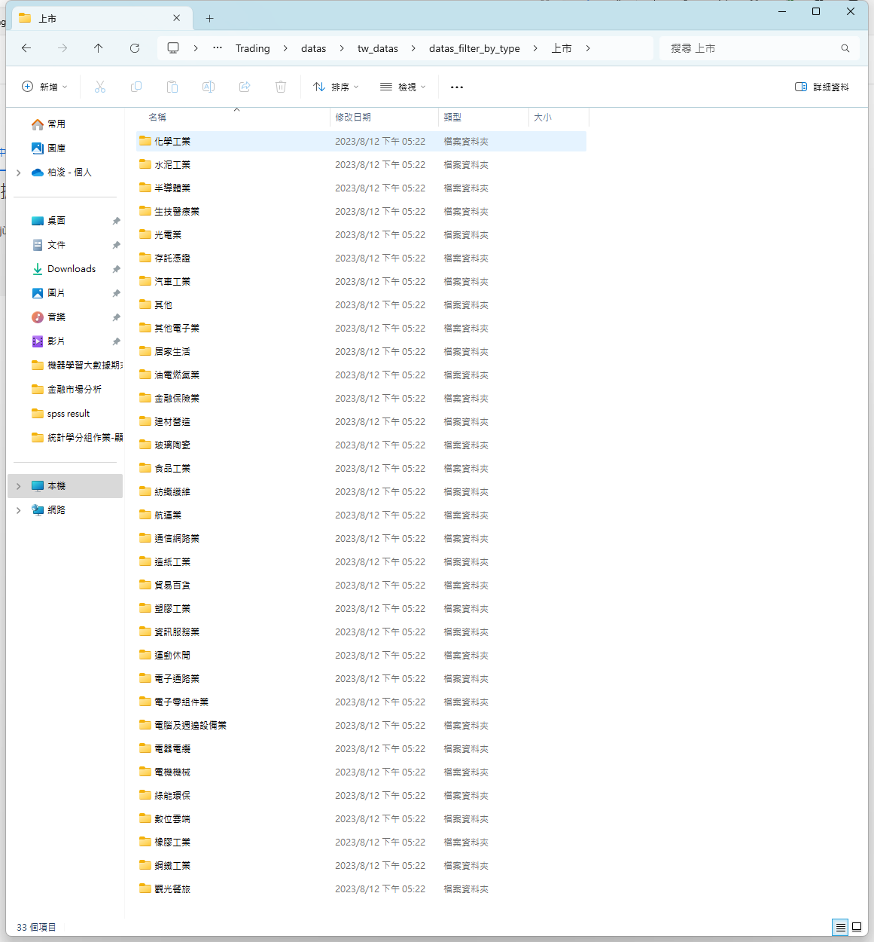
Data Selection
We categorize stocks by industry and conduct tests for each industry.
Notes:
First is data selection, we categorize stocks by industry and conduct tests for each industry

Slide 5
T-test Parameters
N Percentile = 0.95 &
N Days = 90 &
Trade Percentage = 0.05 &
Gap Threshold = 0.03 &
Compare Group base on “IsGap”
Notes:
These are the parameters for our t-test, we used an n percentile of 0.95 and N days of 90 and Trade Percentage of 5% and Gap threshold of 3% and we compare group based on IsGap

Slide 6
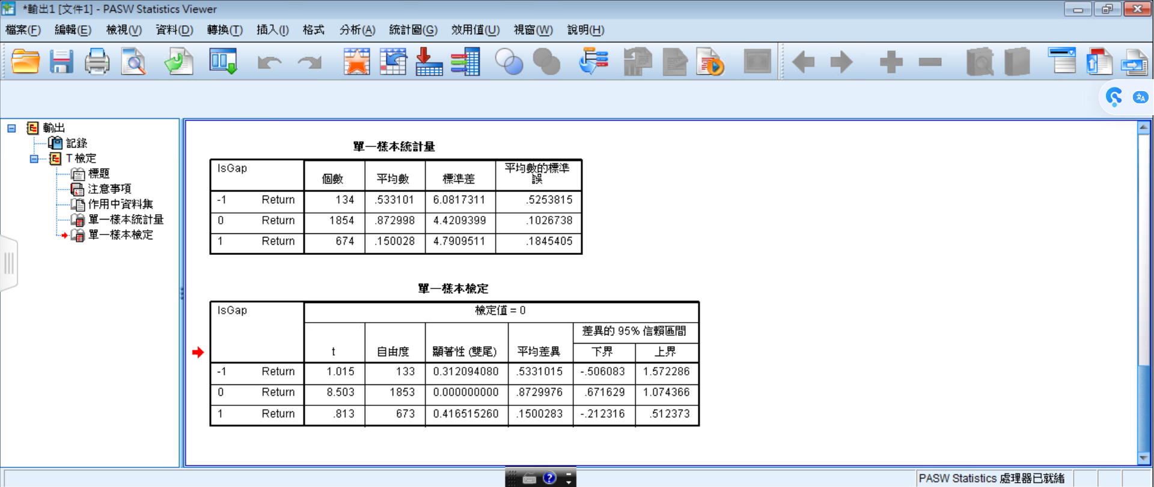
T-test Results Semiconductor Industry ( 半導體業 )
Notes:
Here are our t-test results, this is 半導體業

Slide 7
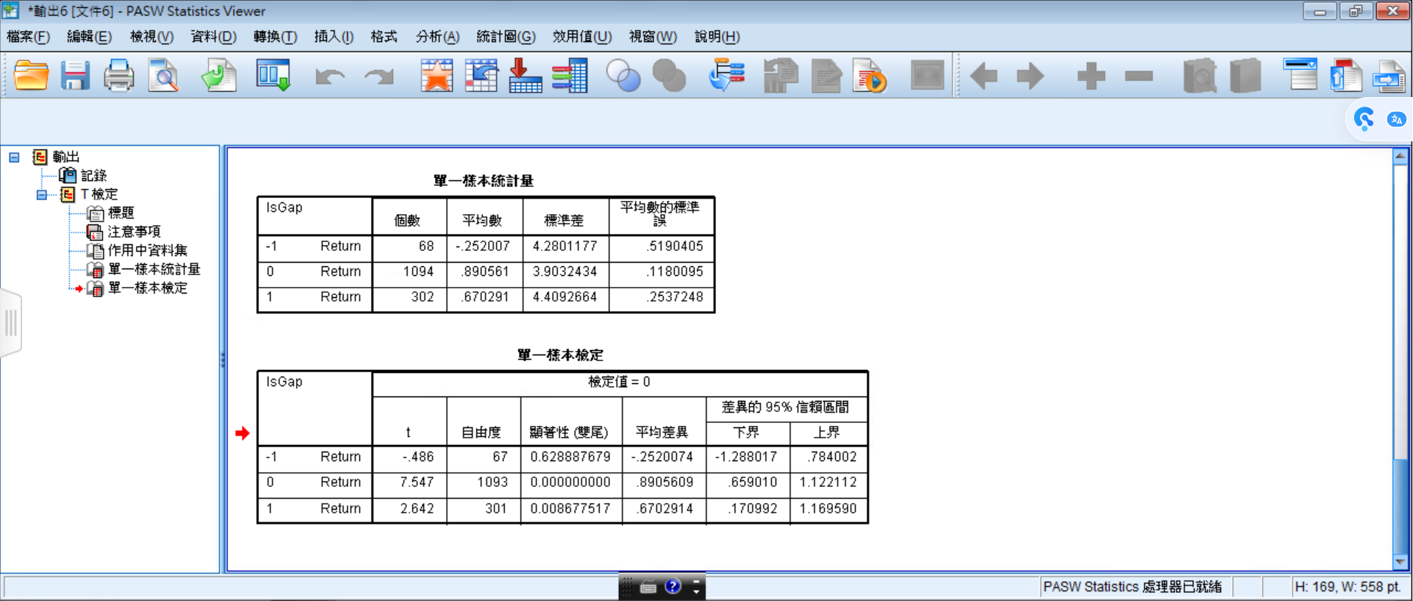
T-test Results Electronic Components Industry ( 電子零件業 )

Slide 8
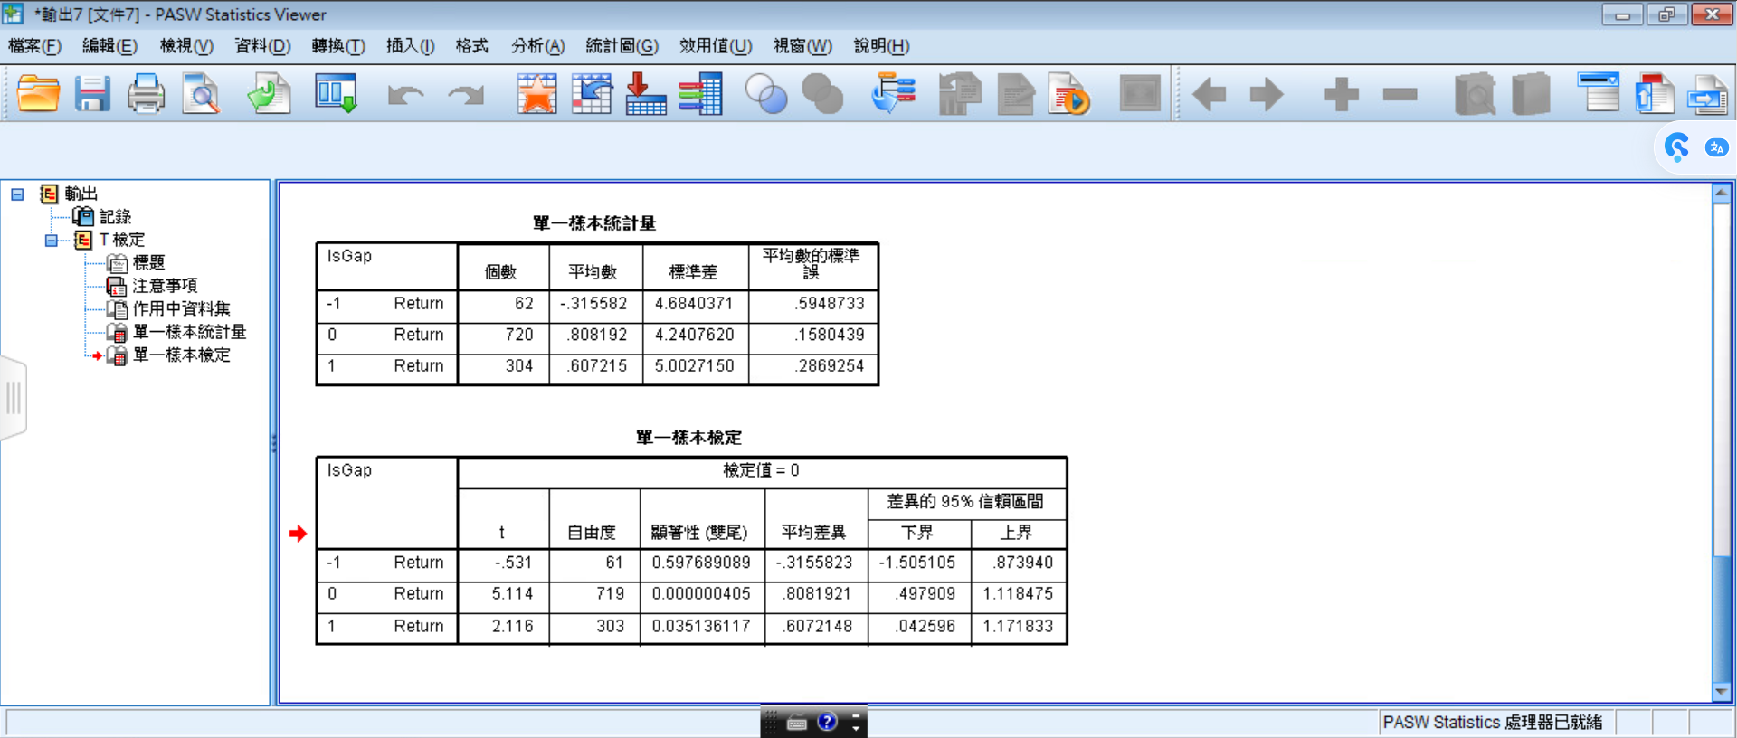
T-test Results Computer Peripheral Industry ( 電腦及周邊設備業 )

Slide 9

T-test Results Electrical Machinery Industry ( 電機機械業 )

Slide 10
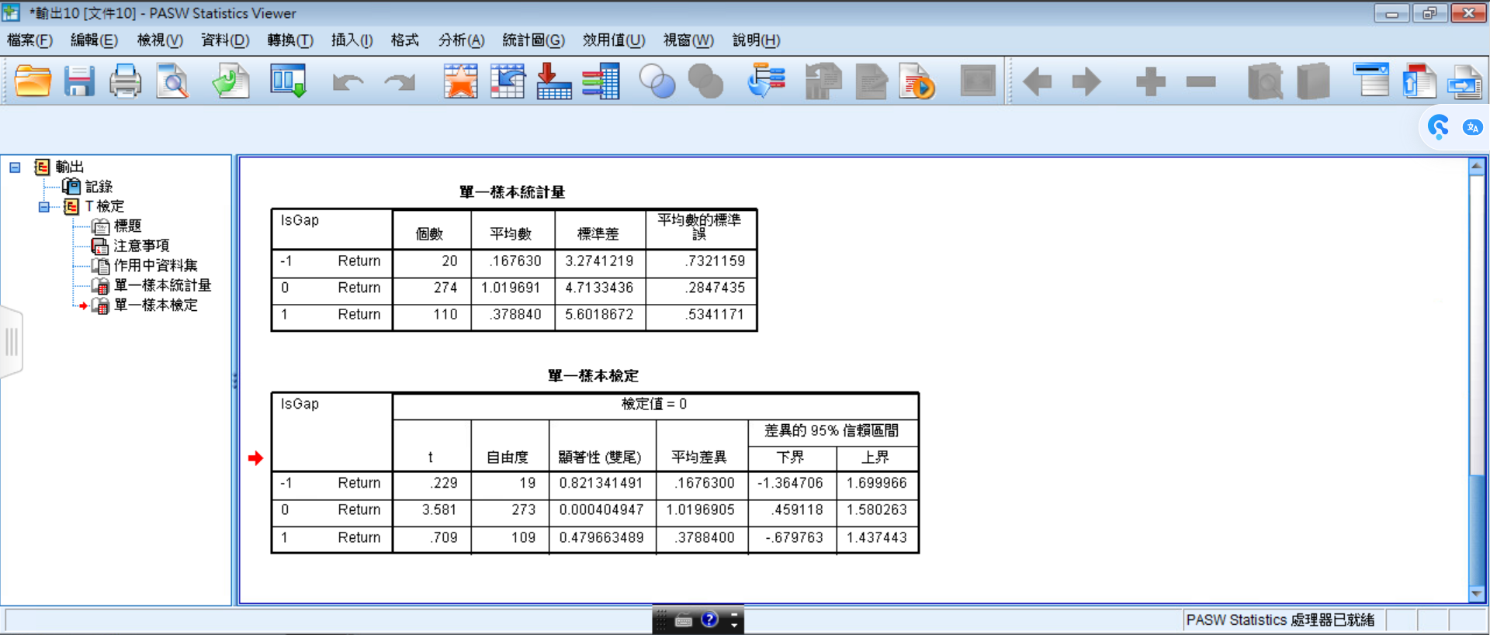
T-test Results Chemical Industry ( 化學工業 )

Slide 11
Conclusion
In the t-test for price gaps, we found that among the well-known industries in Taiwan, stocks with no price gaps exhibit significant differences in return rates.

Slide 12
Questions
What is our next step? Are we using SPSS to identify the optimal parameters?
What subjects do we need to test and compare?
Is our paper only discussing day trading strategies?
Notes:
Here are our questions, first is what is our next steps? Are we using SPSS to identify the optimal parameters? Next is What subjects do we need to test and compare? And last one “Is our paper only discussing day trading strategies?”
”

Slide 13
Thank you

